Slide 1

Unlocking Song Popularity on Spotify
Dive deep into the data behind hit songs and discover what truly resonates with listeners.

Slide 2
Agenda
Project Mission: Predict & Empower
Dataset Snapshot & Features
Popularity Distribution Insights
Genre's Impact on Popularity
Key Feature Importances
Our Modeling Journey
Model Performance Showdown

Slide 3

Project Mission: Predict & Empower
1
Predict Popularity
Using Spotify track features.
2
Identify Key Drivers
Audio and genre insights.
3
Guide Decisions
For artists and producers

Slide 4
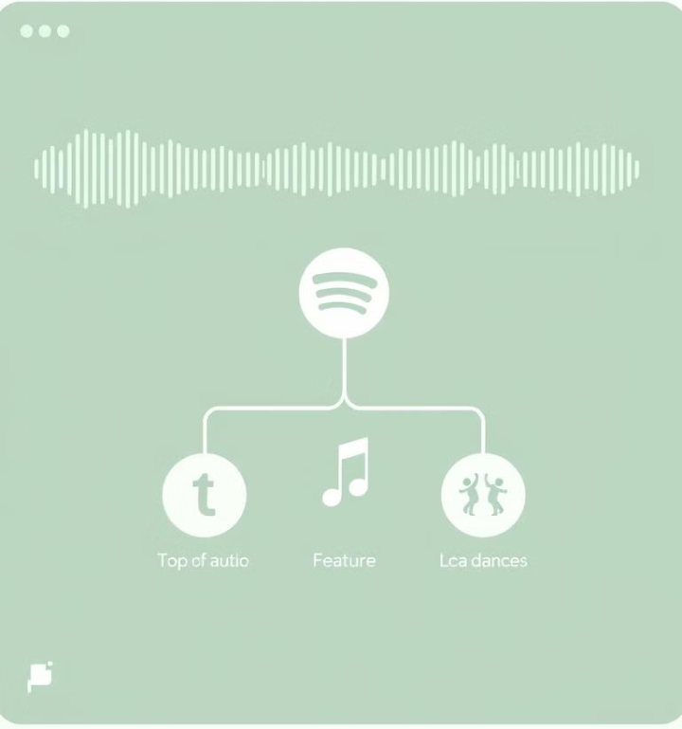
Dataset Snapshot & Features
114,000 Songs
Popularity Score
From Spotify via Kaggle.
Target: 0-100 rating.
Key Features
Genre, danceability, energy, acousticness, valence & more!

Slide 5
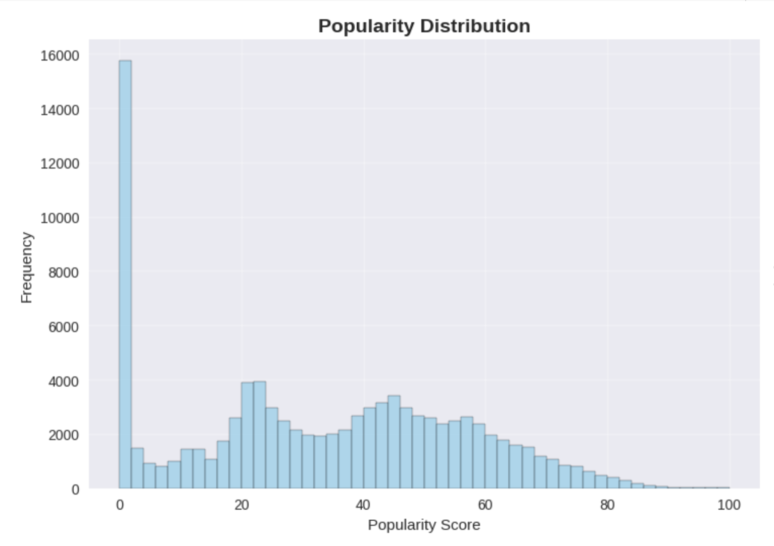
Popularity Distribution Insights
Most songs fall between 0-40 popularity. Only 0.7% achieve viral status, exceeding 80. This right-skewed distribution aligns with industry expectations.

Slide 6
Our Modeling Journey
Baseline
1
Mean-based model.
Linear Regression
2
Simple linear approach.
Tree Models
3
Decision Tree, Random Forest.
Advanced ML
4
XGBoost, Neural Network.
We explored a range of models, from simple baselines to complex neural networks, evaluating their performance against R² and RMSE metrics.

Slide 7
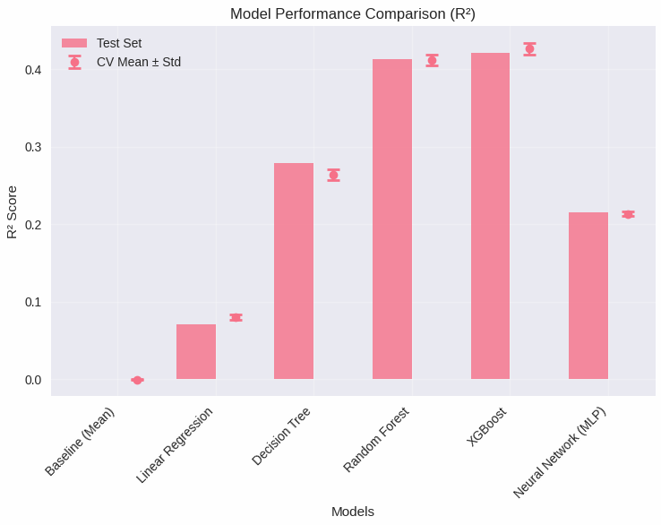
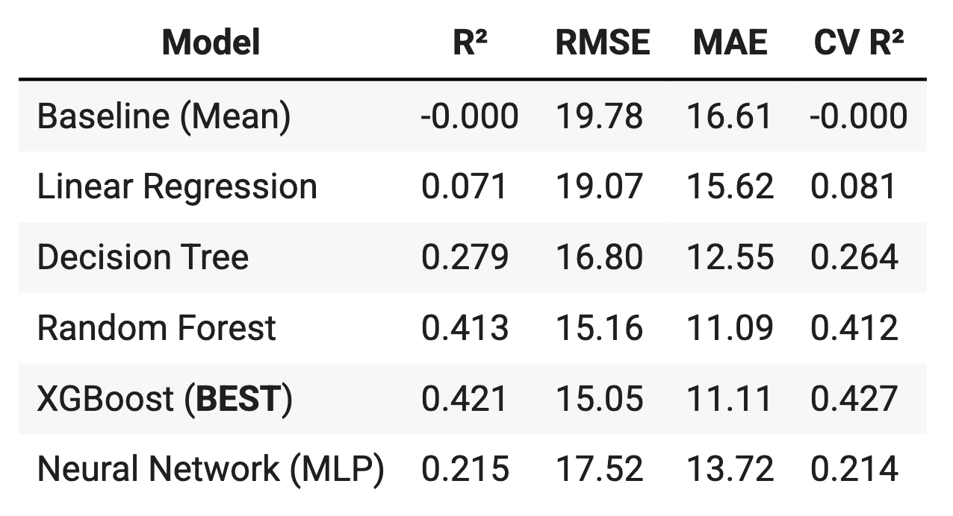
Model Performance Comparison
The XGBoost model emerged as our top performer, achieving an R² of ~0.42 and an RMSE of ~15.05. While Random Forest was close, the Neural Network lagged behind, showing less explanatory power.

Slide 8
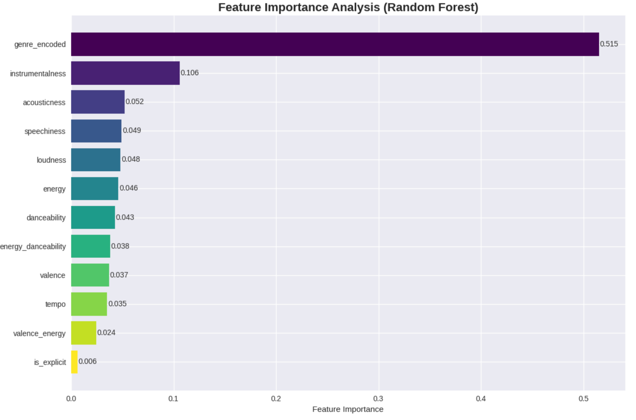
Key Feature Importances
Genre is the most critical feature with 0.47 importance. Instrumentalness, speechiness, acousticness, and loudness are also significant factors. Danceability, energy, and valence have lesser effects.

Slide 9
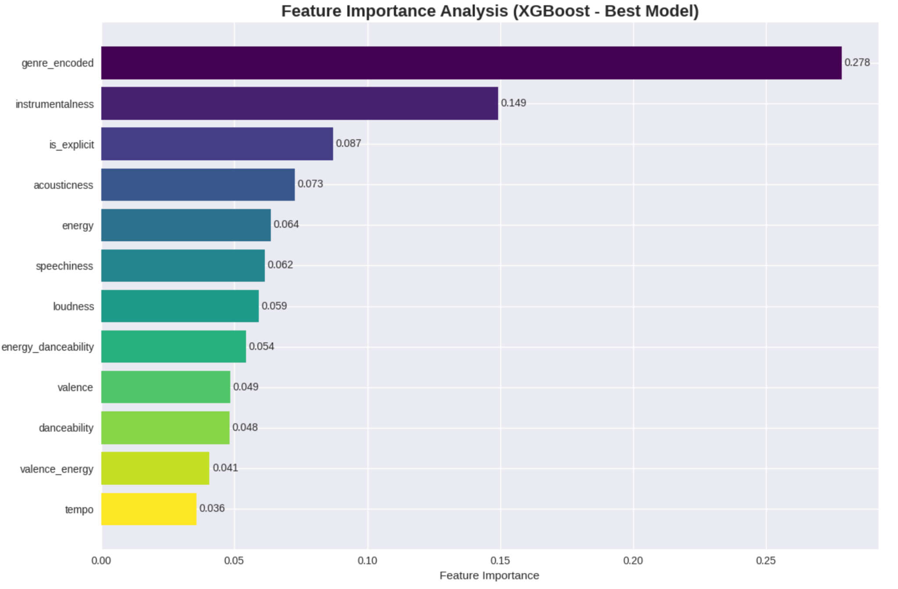
Key Feature Importances
Genre is the most critical feature with 0.47 importance. Instrumentalness, speechiness, acousticness, and loudness are also significant factors. Danceability, energy, and valence have lesser effects.

Slide 10
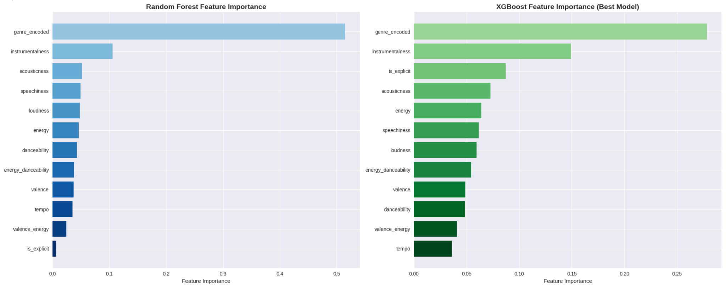
Key Feature Importances
Genre is the most critical feature with 0.47 importance. Instrumentalness, speechiness, acousticness, and loudness are also significant factors. Danceability, energy, and valence have lesser effects.

Slide 11

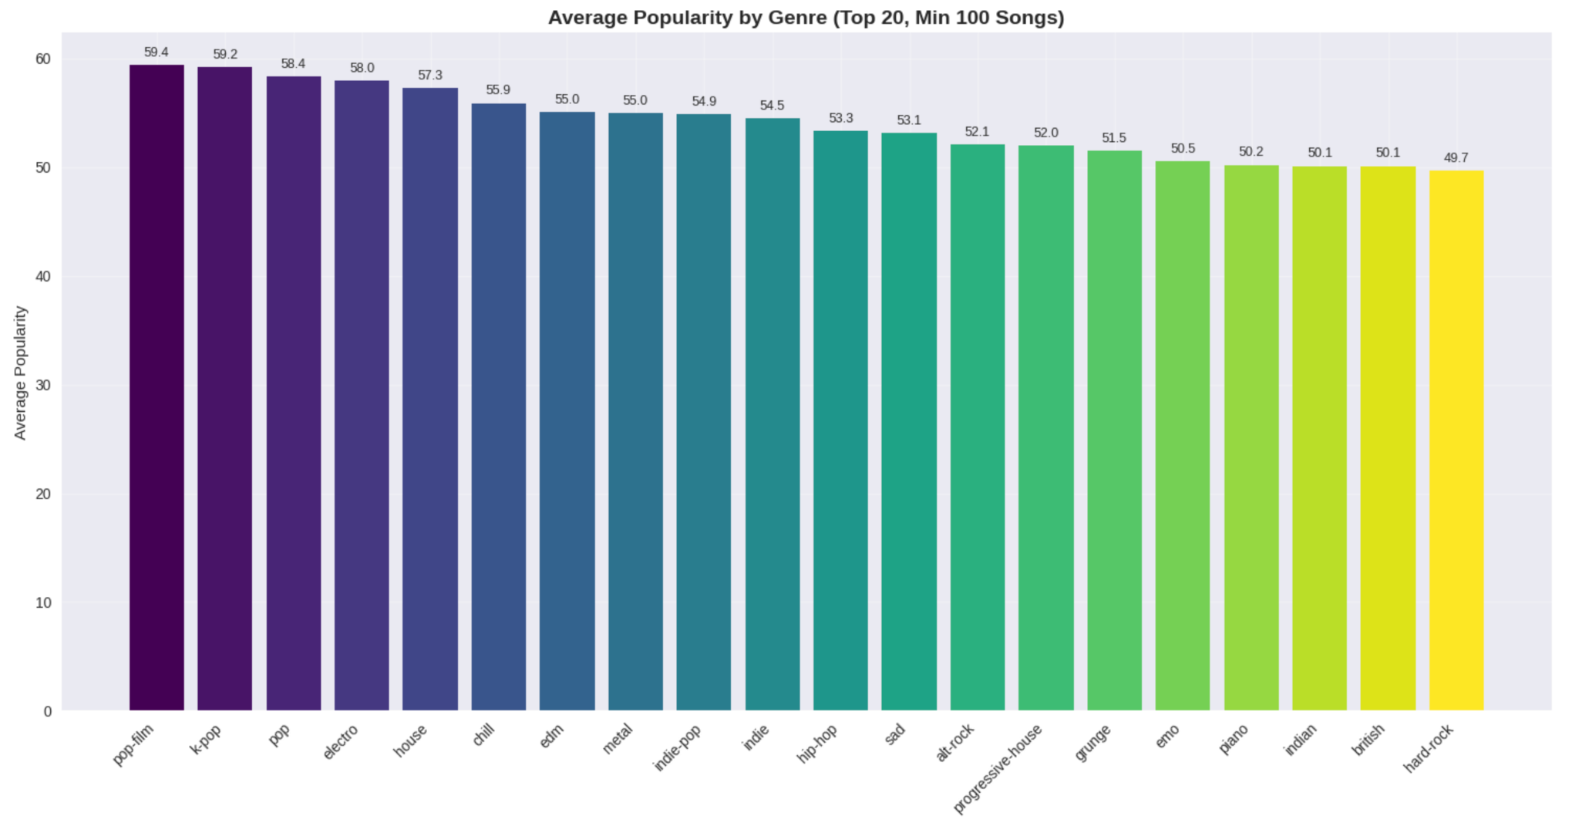



Genre's Impact on Popularity
Top Genres
Pop-film, K-pop, Pop, Electro, House, Chill, EDM
average 55-59 popularity.
Lower Genres
Chicago-house, Detroit-techno, Romance under 20.
Genre Predicts
Crucially predicts audience reach and preference.

Slide 12

Main insights
Lean Into Genre Curation
1
Segment playlists by top-performing genres
Use genre as entry-point to listener personalization
2
Leverage instrumental Quality
Consider producing tracks with strong instrumental elements, especially in lo-fi, chill, or cinematic genres.
1
Explicitness
3
Do not be afraid to incorporate explicit language into your lyrics as explicitly is the third strongest factor to popularity
4
Acousticness + energy
contribute the 4th and 5th most to popularity

Slide 13
Thank you!

